Slide 1
Amazon Web Services
Let’s Cloud

Slide 2
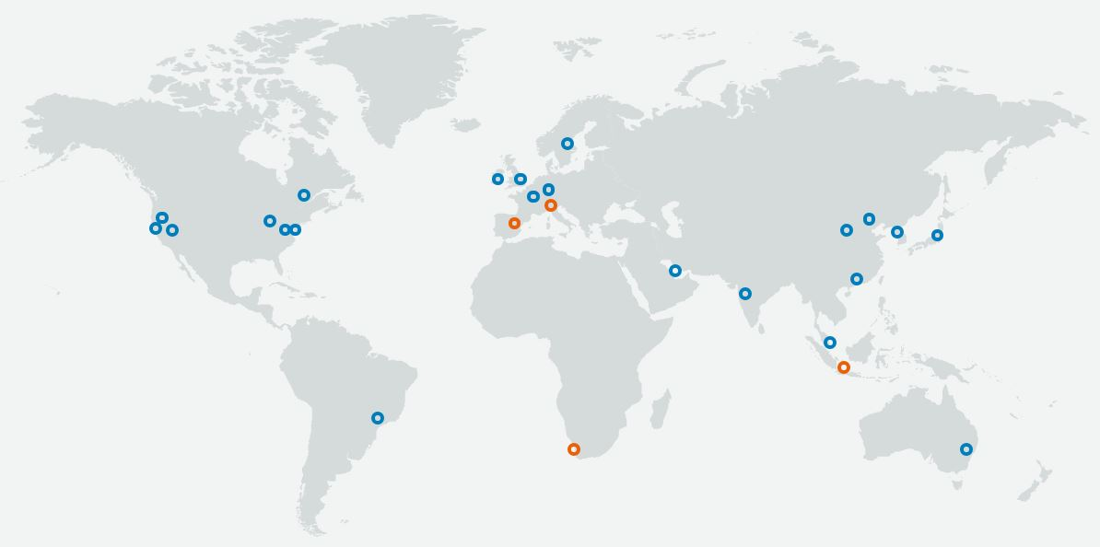
What Exactly is AWS ?
It is one of the public cloud service provider which has more than 140+ services.
knowledge portal

Slide 3
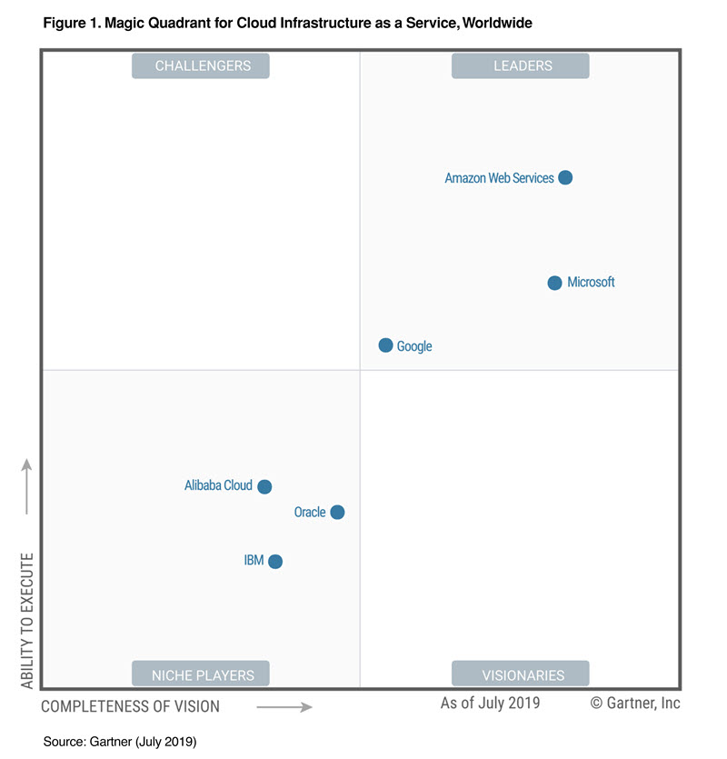
Gartner’s Magic Quadrant
knowledge portal

Slide 4
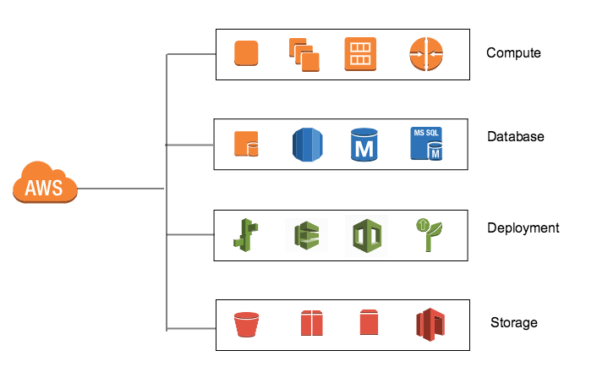
AWS Services
AWS has broad range of services available for compute, storage, database, analytics, encryption, deployment and many more.
With pay as you go model, it reduces the overall costs and help you scale your applications.
knowledge portal

Slide 5
AWS Services - Master Stroke
Real World Scenario - Storage :
Organizations used to invest tens of thousands of dollars in building their storage solutions for backups. This used to take significant amount of time and high investment.
With AWS S3, in click of an upload button, you get 99.999999999% durability in little less than a minute of work.
knowledge portal

Slide 6
Pay as you go Model
Pay as you consume model allows organizations to scale their resources well and only pay for what they have used.
Generally, the model works based on hourly costs.
This model is terrific especially due to AWS Marketplace support.
Old Bill Utility
Newer Bill
knowledge portal

Slide 7
AWS Global Infrastructure
Public Cloud Solutions

Slide 8
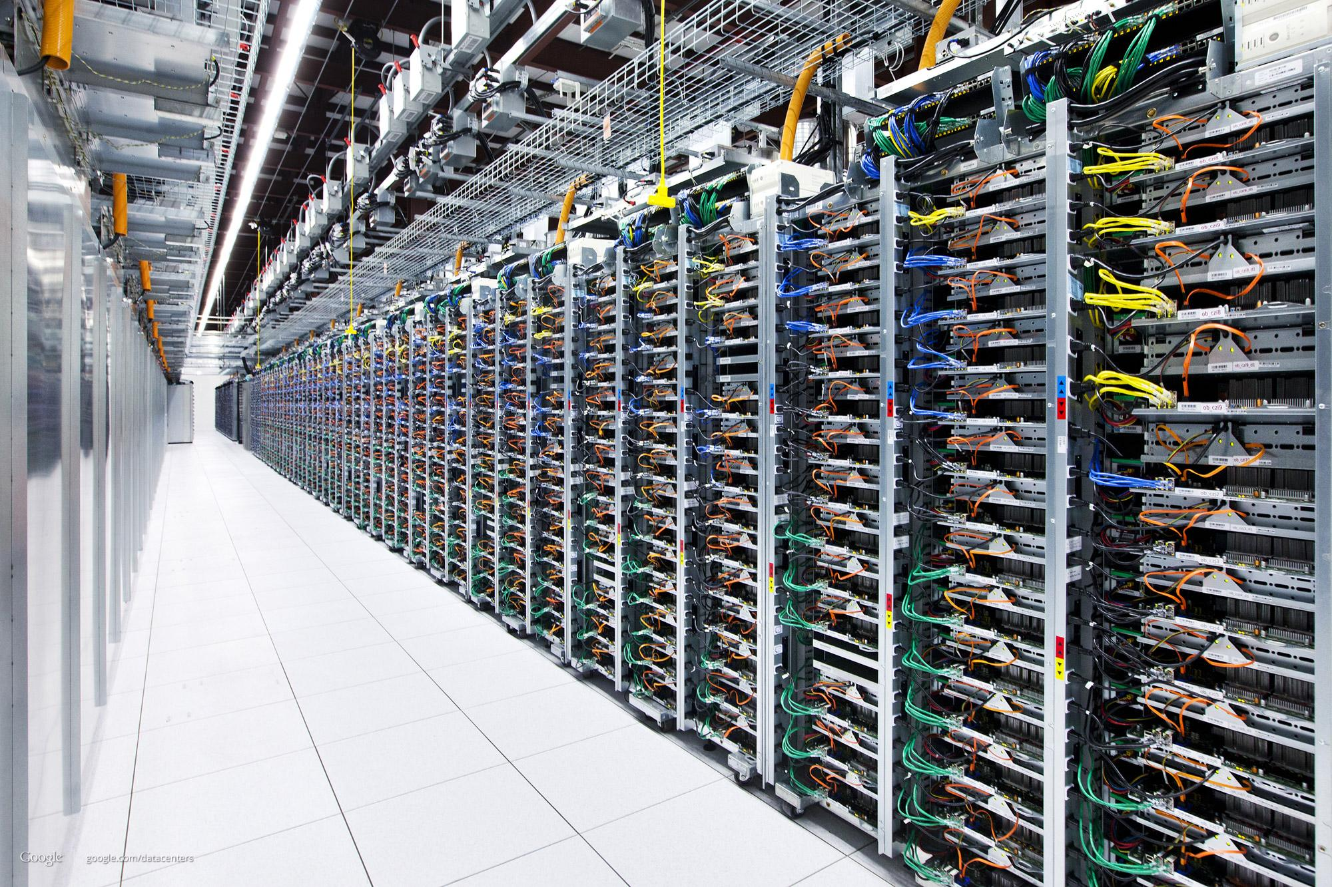
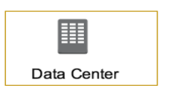
AWS Data Centers
A single data center typically has 1000s of servers.
What if data center goes down ?
knowledge portal

Slide 9
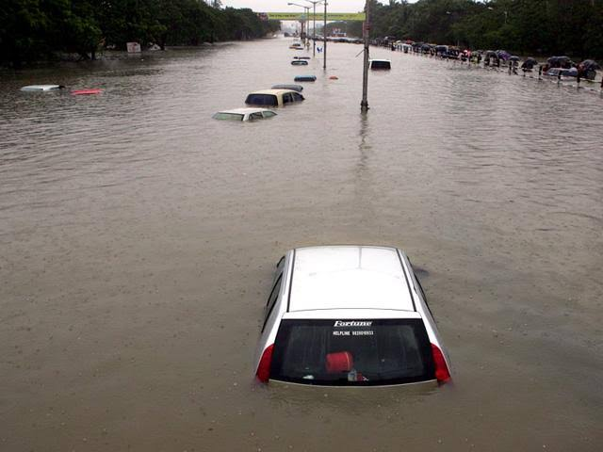
Real World Scenarios
In Mumbai, there were very heavy rains in 2005.
Lot of people were affected.
Lot of Data Centers were also affected.
knowledge portal

Slide 10
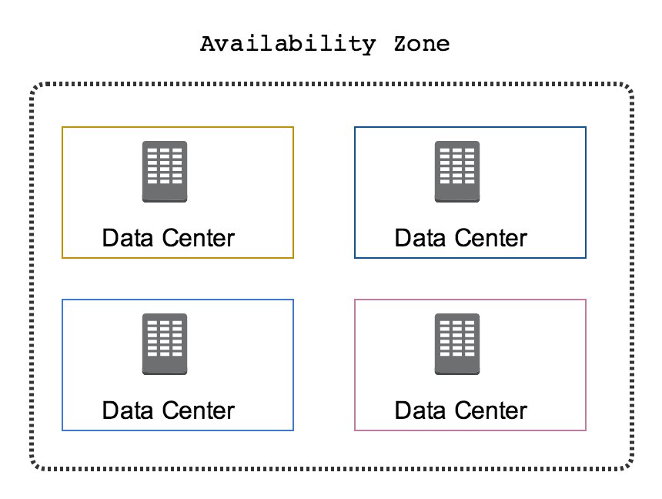
Availability Zone
AWS Data Centers are organized into Availability Zones (AZ)
Each availability zone are located at lower-risk locations.
There are multiple AZ and each of them is separate by geographic region
knowledge portal

Slide 11
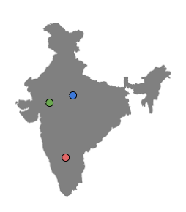
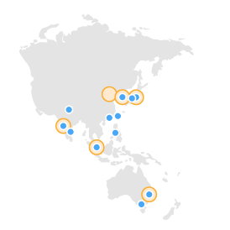
Availability Zone - Part 2
Each AZ is designed for independent failure zone.
Thus, they are physically separated.
The AZ are inter-connected with high speed private links.
Each availability zone are located at lower-risk locations.
knowledge portal

Slide 12
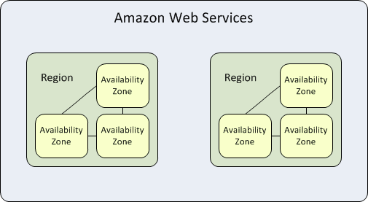
AWS Regions
Each region contains two or more availability zones.
AWS has 22 number of regions worldwide and the number keeps increasing.
knowledge portal

Slide 13
AWS Global Infrastructure
AWS currently operates on 22 regions across the world with 69 availability zones.
knowledge portal

Slide 14
Setting up the Lab
Let’s start Rolling !

Slide 15
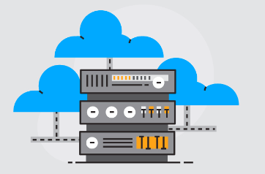
Let’s Start
i) Create a new AWS Account.
ii) Begin the course
knowledge portal

Slide 16
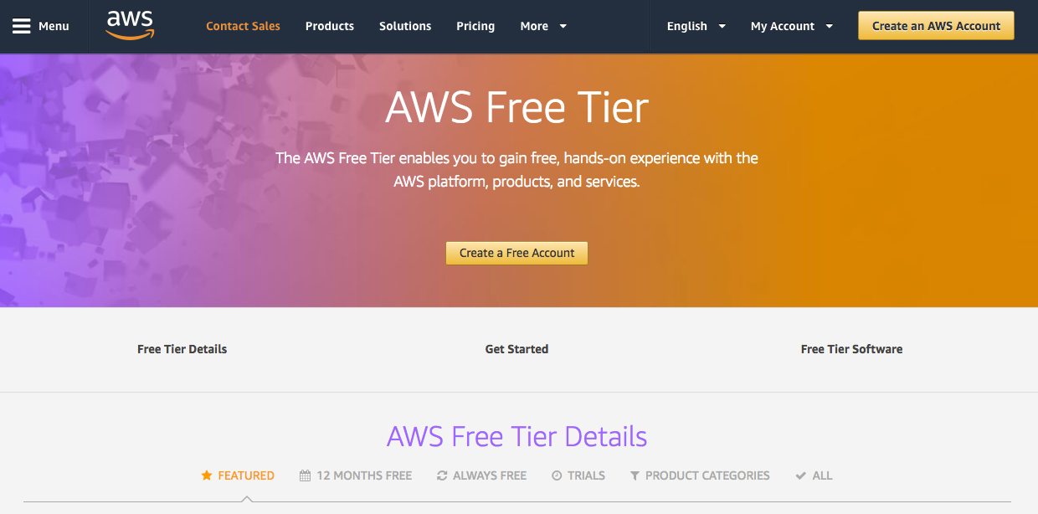
Registering an AWS Account
knowledge portal

Slide 17
Setting Up SSH Client
Let’s Begin our Journey

Slide 18

Connecting to a Server
After you have launched a server, you need to connect to it to perform administrative tasks.
Depending on OS of the server, tools to connect will change.
Server
Hey, can you host my website?
Definitely
knowledge portal

Slide 19
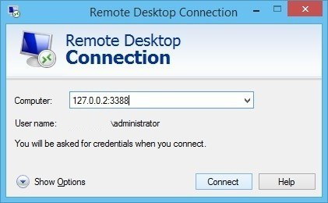
Connecting to a Server
For Linux Server, you will need a SSH Client to connect.
For Windows Server, you will need an RDP client to connect.
knowledge portal

Slide 20
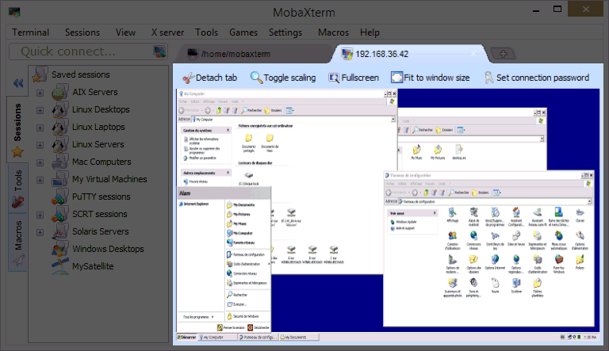
Using MobaXterm
For our labs, we will be making use of MobaXterm which comes with SSH client.
Along with SSH client, it comes with various other useful commands like telnet, curl.
MAC and Linux comes with its own terminal which has SSH client. You can skip this step.

Slide 21
Key Based Authentication
Back to Security!

Slide 22
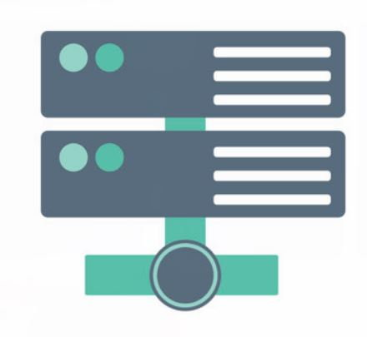

Password Based Authentication
There can be multiple methods for authentication against a system.
Password based authentication is the simplest form.
My username is admin, I want to login
Hey there, what is your password?
Laptop
Linux Server
knowledge portal

Slide 23
Login with Credentials
My username is admin, my password is 12345. I want to login.
Login successful.
Laptop
Linux Server
knowledge portal

Slide 24

Challenges with Password Based Authentication
Password based authentication is generally considered to be less-secure.
Many users write down the passwords in notepad files or as part of sticky notes.
Most users would not create a complex password that is difficult to hack.
knowledge portal

Slide 25
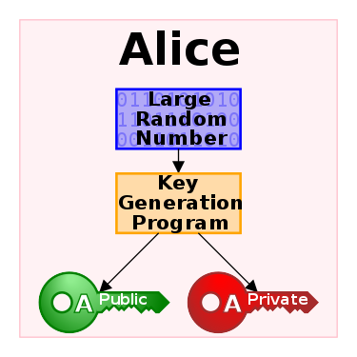
Key Based Authentication
In this type of authentication, there are two special keys that are generated.
One key is called as Public Key and second key is called as Private key.
If public key is stored in server and is used as authentication mechanism, only the corresponding private key can be used to successfully authenticate.
knowledge portal

Slide 26


Key Based Authentication
My username is admin, I want to login
Hey there, password is not allowed. You need to authenticate via the key.
Laptop
Linux Server
knowledge portal

Slide 27
Creating our First EC2 Instance
Let’s Start

Slide 28

Overview of EC2
EC2 stands for Elastic Compute Cloud.
In-short, it's a name for a server that you launch in AWS.
Server
EC2 Instance
knowledge portal

Slide 29
Important Configuration
There are certain important configuration that you need to know while launching a new EC2 instance in AWS
The CPU and Memory Size
Operating System (Linux, Windows)
Storage Capacity
Authentication Key
Security Group
EC2 Instance
knowledge portal

Slide 30
Connecting to a Server
After you have launched a server, you need to connect to it to perform administrative tasks.
Depending on OS of the server, tools to connect will change.
Server
Can you run my command?
Definitely
knowledge portal

Slide 31
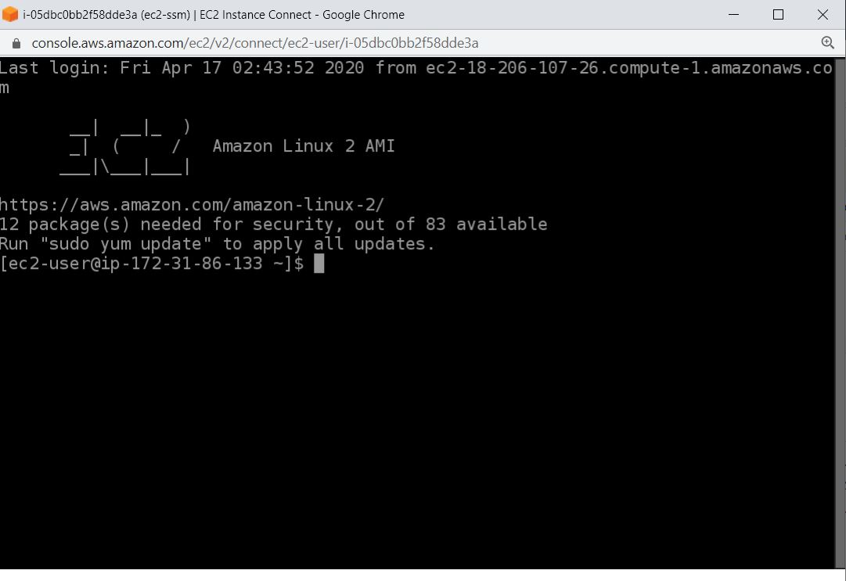
Browser Based SSH Connection
Browser Based SSH Connection allows you to directly connect to EC2 instance from browser.
No need to maintain keys or have SSH client.
knowledge portal

Slide 32
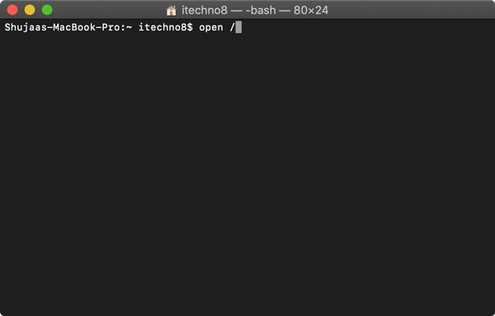
MAC Terminal
knowledge portal

Slide 33

Creating our First Website
We have our EC2 instance up and running.
Let’s go ahead and create our first website.
www.example.com
EC2 Instance
knowledge portal

Slide 34
Requirements for Website
Server.
Software on server that web-browsers can interact with (web-server)
www.example.com
S
EC2 Instance
knowledge portal

Slide 35
Understanding Firewalls
Firewall without a Fire !

Slide 36
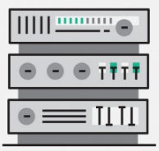
Understanding Ports
A port is a logical entity which acts as a endpoint of communication to identify a given application or process on an Linux operating system
Opening 22
SSH
Opening 80
HTTPD
User from Internet
knowledge portal

Slide 37
Understanding Firewall
Firewall is a network security system that monitors and controls incoming and outgoing network traffic based on predetermined security rules.
Firewall
Connect to 22
Opening 22
SSH
Opening 80
HTTPD
User from Internet
Deny connect to 22
Allow connect to 80

Slide 38
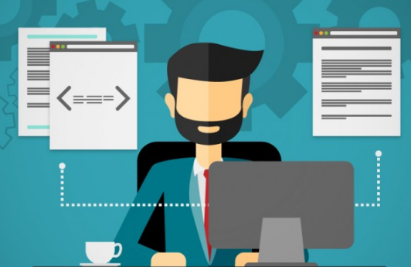

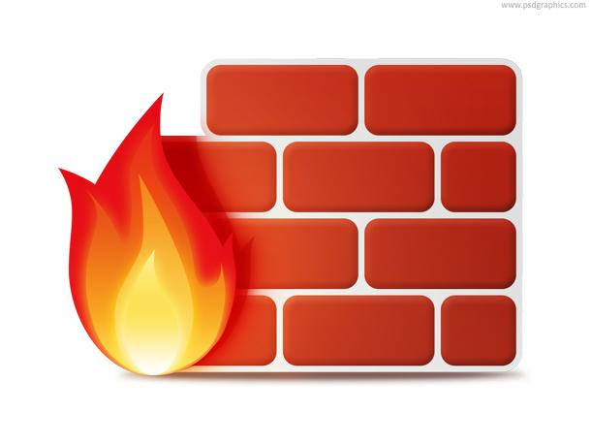

Allow from Trusted Block from Hackers
knowledge portal

Slide 39

Firewall in AWS
A security group acts as a virtual firewall for your instance to control inbound and outbound traffic.
Inbound Connection
EC2
Outbound Connection
knowledge portal

Slide 40
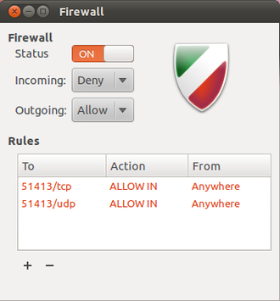
Understanding Firewalls
Firewall is a network security system that monitors and controls incoming and outgoing network traffic based on predetermined security rules.
There can be both hardware based firewalls and software based firewalls.
knowledge portal

Slide 41

knowledge portal

Slide 42
How does it do that ?
ssh serverA
Apache 80
SSH 22
FTP 21
SMTP 25
MySQL 3306
IP : 10.0.5.57
IP : 112.20.50.60

Slide 43
AWS Budgets
Free Tier is Important

Slide 44
Overview of AWS Budgets
AWS Budgets gives you the ability to set custom budgets that alert you when your costs or usage exceed (or are forecasted to exceed) your budgeted amount.
Let’s understand this with an example:
John has created a new AWS account and want to be under free tier.
He wants to be notified whenever there is a charge of more then $1
knowledge portal

Slide 45
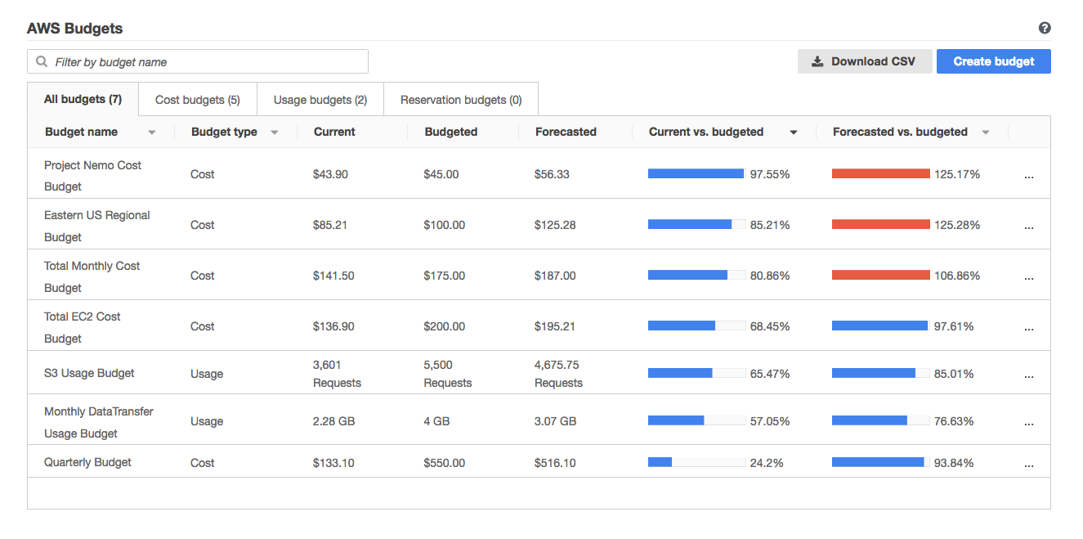
knowledge portal

Slide 46
Virtual Private Cloud
Do things the right way

Slide 47
Let’s understand with a use-case
John works as Finance manager. He is migrating to a new city because of his job and plans to live in an apartment.
House 1
House 2
knowledge portal

Slide 48
Analogy in terms of servers
5 servers are planned to be migrated to cloud.
The location where they can be launched in AWS is VPC.
VPC
VPC
knowledge portal

Slide 49
Let’s understand with a use-case
John has decided to buy a new house. For additional income, he has decided to rent part of hise house . John decides to partition his house.
Partition 1
Partition 2
knowledge portal

Slide 50
Let’s understand with a use-case
Among the 5 servers, we have decided following architecture:
Launch 3 servers in first partition (subnet 1)
Launch 2 servers in second partition (subnet 2)
Subnet 1
Subnet 2

Slide 51
Additional Layer of Security - Partition Wise
John can decide to have additional layer of security in each partition.
Partition 1
Partition 2
knowledge portal

Slide 52
Additional Layer of Security - Partition Wise
John decides to build two entrance so that individuals in partition 1 can directly go out of the house.
Hypothetically imagine that no doors for partition 2 so no one can go out.
Partition 1
Partition 2
knowledge portal

Slide 53
Additional Layer of Security - Partition Wise
Solutions Architect creates a route so that servers from subnet 1 can connect to the internet.
For subnet 2, no routes has been created hence servers cannot reach the internet.
Subnet 1
Subnet 2
knowledge portal

Slide 54
Inter-Communication
There can be a need for servers from two subnets to speak with each other.
So you can create a route that can allow communication between two subnets.
Subnet 1
Subnet 2
knowledge portal

Slide 55
Inter-Communication
There can be a need for servers from two subnets to speak with each other.
So you can create a route that can allow communication between two subnets.
Subnet 1
Subnet 2
knowledge portal

Slide 56
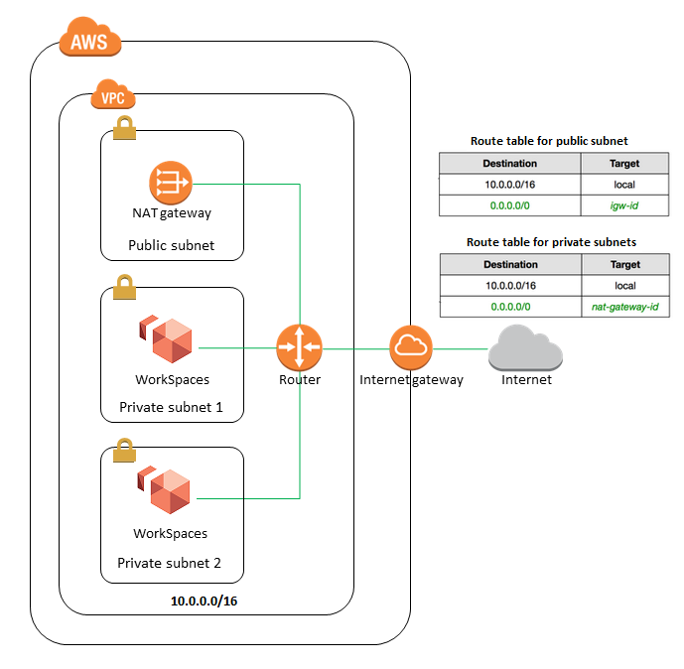
Important Learnings
Every EC2 instance that we create should be under a VPC.
EC2 instance launched in a VPC will be protected or not protected based on configuration of VPC.
Architecture changes when you go into more technical aspect.

Slide 57
Creating our first VPC
Let’s start!

Slide 58

Revising Basics of VPC
Amazon Virtual Private Cloud (Amazon VPC) enables you to launch AWS resources into a virtual network that you've defined.
EC2 instances inside VPC will be able to communicate to each other using private network.
10.77.0.5
10.77.0.6
VPC - 10.77.0.0/16
knowledge portal

Slide 59

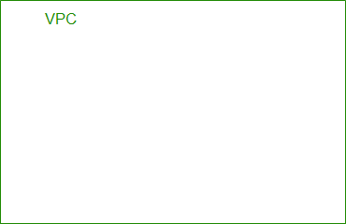
Today’s Practical
Name: demo-vpc
IPv4 CIDR Block: 10.77.0.0/16
knowledge portal

Slide 60
Important Note
Every region in AWS has a default VPC with CIDR range of 172.31.0.0/16.
This allows customers to start launching EC2 without having to manually create a VPC.
knowledge portal

Slide 61
Creating Subnets
Let’s create Subnetworks

Slide 62

Creating Subnetworks - Analogy
Each subnet has its own set of range that is derived from the larger VPC range.
VPC (0-100)
Subnet 1 (1-50)
1
15
Subnet 2 (51-100)
55
84
knowledge portal

Slide 63
Creating Subnetworks - Technical
VPC (10.77.0.0/16)
Subnet 1 (10.77.2.0/24)
10.77.2.5
Subnet 2 (10.77.4.0/24)
10.77.4.5
/16 = 65536 IP Addresses
/24 = 256 IP Addresses
knowledge portal

Slide 64
Creating Subnet Process
When you create a subnet, following are some of the important setting that need to be configured.
Setting | Description
VPC | The VPC ID to which subnet would be associated.
Availability Zone | Availability zone in which subnet will reside in.
IPv4 CIDR Block | Smaller CIDR block from the Main VPC Range.
Subnet Name | Name of the Subnet.
knowledge portal

Slide 65
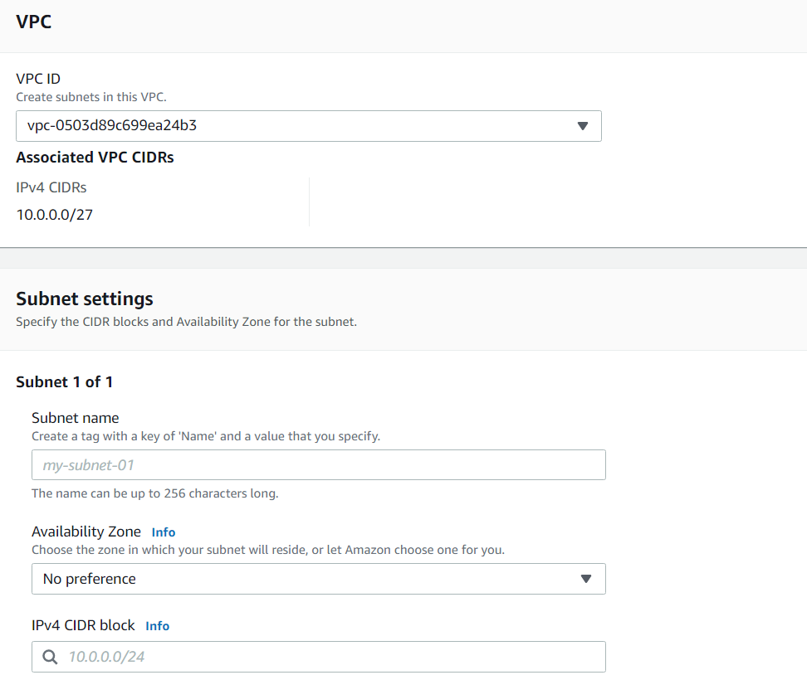
knowledge portal

Slide 66
Internet Gateway
Connect to Internet

Slide 67

Simple Analogy
You have recently moved to a new house.
You have a laptop and you want to watch some Youtube videos.
But there is no Internet connectivity in your house.
knowledge portal

Slide 68

VPC Network
The EC2 instances inside VPC will be able to communicate with each other.
They will NOT be able to connect to Internet.
Internet
10.77.0.5
10.77.0.6
VPC - 10.77.0.0/16
knowledge portal

Slide 69
Internet Gateway
An internet gateway is a component that allows communication between your VPC and the internet.
It allows both inbound as well as outbound communication.
IGW
10.77.0.5
10.77.0.6
Internet
VPC - 10.77.0.0/16
knowledge portal

Slide 70
Route Tables
Let’s Route

Slide 71
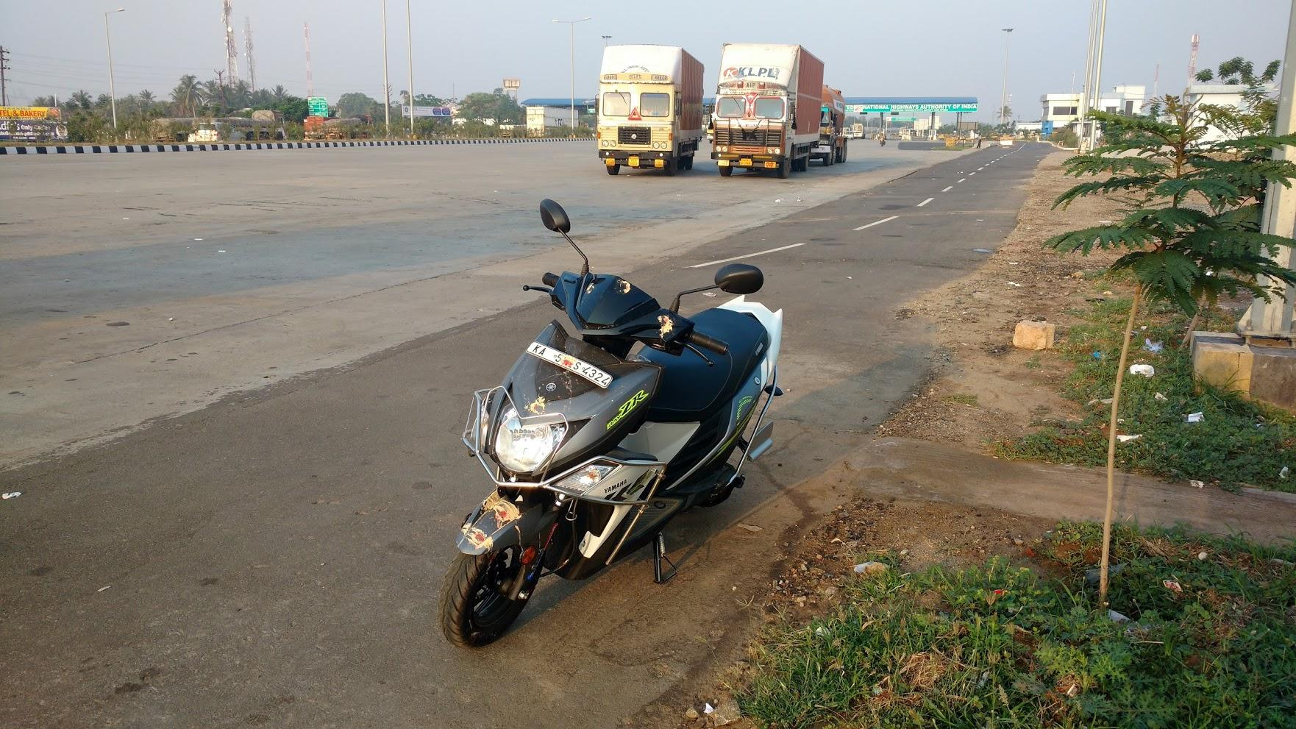
Simple Analogy
Few years back, I had a trip from Coimbatore to Bangalore (~400 kms) in scooty.
Direction was a key factor here.
knowledge portal

Slide 72
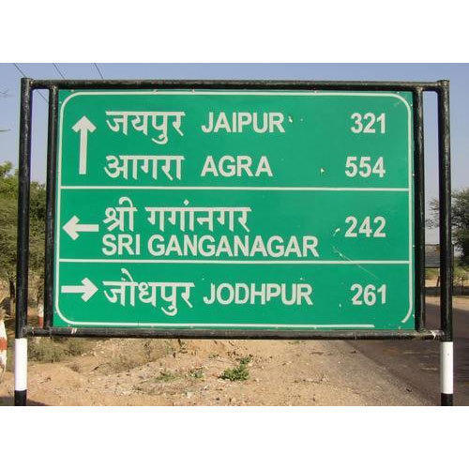
Direction Billboards
Direction Billboards are very useful to determine the next turning point to reach the destination.
knowledge portal

Slide 73

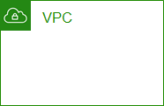
Overview of Routers
A router is a networking device that forwards data packets between networks.
Each router has a route table that contains the routing rules.
Connect to 10.77.0.5
Internet
Destination | Next Hop
10.77.0.0/16 | VPC
0.0.0.0/0 | Internet
Route Table

Slide 74




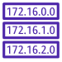
Route Table in AWS
A route table contains a set of rules, called routes, that determine where network traffic from your subnet or gateway is directed.
By default, whenever a VPC is created, the route table is also created.
Towards Internet
VPN
VPC
IGW
Route Table

Slide 75
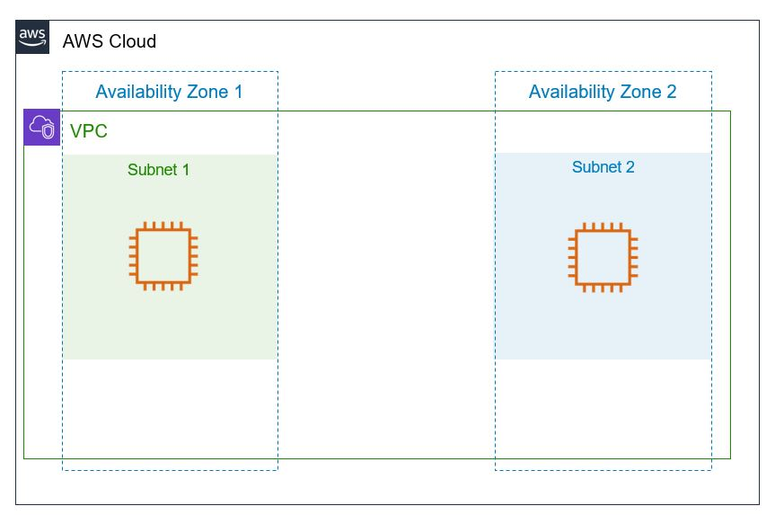

High-Level Working - Internet Route
knowledge portal

Slide 76
High-Level Working - Local Route
10.77.2.5
knowledge portal

Slide 77
Public and Private Subnets
Important Architecture Concept

Slide 78
Public Subnet
Public subnet is a subnet that is associated with an Internet Gateway.
This subnet is recommended if you want to run a public-facing web application.
Overall Security Risk: High
knowledge portal

Slide 79

Private Subnet
Private subnets are the ones that do not have an Internet Gateway attached to it.
No New connections from the Internet can reach to the EC2 instances within the private subnet.
knowledge portal

Slide 80


Benefits of Private Subnet
Since internet connectivity is not present, it is much more difficult by an attacker to attack the system in private subnet directly.
Attack Attack!
Oh No! EC2 is in Private Subnet
Attacker
Private Subnet
knowledge portal

Slide 81
Important Note
Even though the EC2 instance are in private subnet, the local level communication between EC2 in public and private will still work using private IPs.
Attack Public Subnet EC2
Public Subnet
Attacker
Private Subnet
knowledge portal

Slide 82
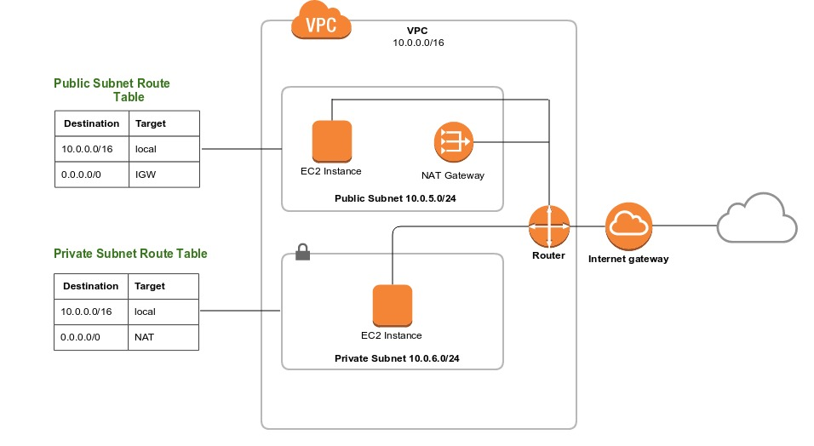
The Network Architecture
knowledge portal

Slide 83
Configuring Public and Private Subnet
Better Architecture

Slide 84


Public Subnet Configuration
Following is true for Public Subnet:
Internet Gateway is Attached to VPC
Route Table has route towards Internet Gateway.
Internet Gateway
Public Subnet
Destination | Target
10.77.0.0/16 | local
0.0.0.0/0 | Internet Gateway

Slide 85
Private Subnet Configuration
Following is true for Private Subnet:
Route Table does not have a route towards Internet Gateway.
Internet Gateway
Private Subnet
Destination | Target
10.77.0.0/16 | local

Slide 86
Steps to Configure Public and Private Subnet
There will be 2 route tables: One for Public Subnet and Second for Private Subnet.
Destination | Target
10.77.0.0/16 | local
0.0.0.0/0 | Internet Gateway
Public Subnet
Destination | Target
10.77.0.0/16 | local
Private Subnet

Slide 87
NAT Gateway
Allow Outbound Internet Connectivity

Slide 88
Challenge with Instance in Private Subnet
Since there is no Internet connectivity in Private subnet, the EC2 instance and application inside it will not be able to perform any kind of patch updates, download new softwares etc.
Internet Gateway
Private Subnet
knowledge portal

Slide 89

Overview of NAT Gateways
NAT Gateway allows instances in the private subnet to initiate a new connection towards the Internet.
New connections from Internet cannot be established to instances in Private subnet.
NAT Gateway
knowledge portal

Slide 90





Working of NAT Gateway
Private EC2 NAT Internet Gateway Internet
knowledge portal

Slide 91


Example 2 - NAT Gateway
Private EC2 NAT Internet Gateway Internet
knowledge portal

Slide 92
New VPC Create Experience
Create VPC Quickly

Slide 93
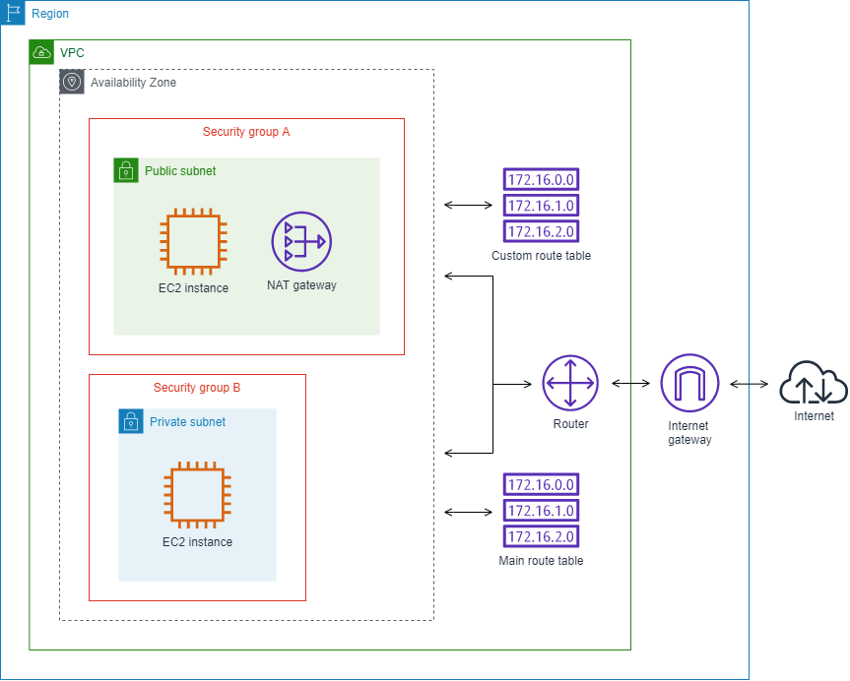
Understanding Challenge
If you want to create a new VPC setup, there are multiple components that you have to configure:
VPC, Subnets, Route Tables, NAT Gateway, Internet Gateways
knowledge portal

Slide 94
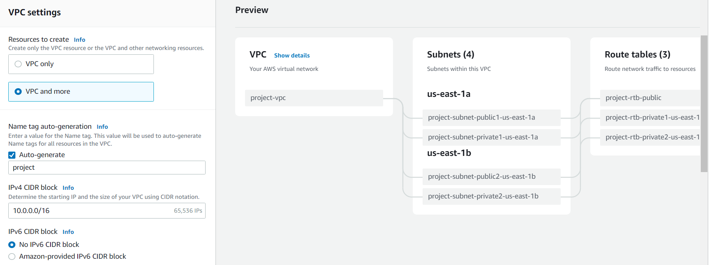
New VPC Create Experience
AWS has released a new VPC Create Experience that allows us to quickly setup entire VPC infrastructure with click of just few buttons.
knowledge portal

Slide 95
VPC Peering
Let’s Route

Slide 96


VPC Peering
VPC peering is a network connection between two VPC that enables the communication between instances of both the VPC.
172.31.0.0/16
10.77.0.0/16
knowledge portal

Slide 97
Today’s Architecture - 1
First VPC - 172.31.0.0/16
Secondary VPC - 10.77.0.0/16
172.31.0.0/16
10.77.0.0/16
knowledge portal

Slide 98
Today’s Architecture - 2
10.66.0.0/16
172.31.0.0/16
10.77.0.0/16

Slide 99
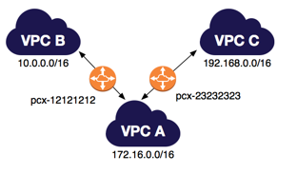
Things to Remember
VPC Peering is now possible between regions.
VPC Peering does not act like a Transit VPC
knowledge portal

Slide 100
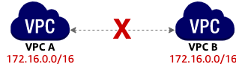
Unsupported VPC Peering Configurations - 1
You cannot create a VPC peering connection between VPCs with matching or overlapping IPv4 CIDR blocks.
knowledge portal

Slide 101
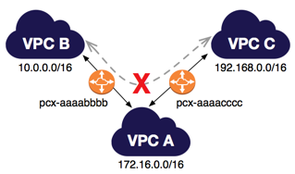
Unsupported VPC Peering Configurations - 2
You have a VPC peering connection between VPC A and VPC B (pcx-aaaabbbb), and between VPC A and VPC C (pcx-aaaacccc).
There is no VPC peering connection between VPC B and VPC C. You cannot route packets directly from VPC B to VPC C through VPC A.
knowledge portal

Slide 102
Network ACL
Multiple Layers for Defense

Slide 103

Understanding the Basics
A network access control list (ACL) is an optional layer of security for your VPC that acts as a firewall for controlling traffic in and out of one or more subnets.
Security Group works at an EC2 instance level.
Network ACL works at a Subnet Level.
Public/Private Subnets
Security Group
Network ACL
knowledge portal

Slide 104
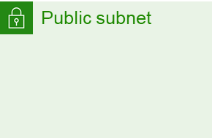
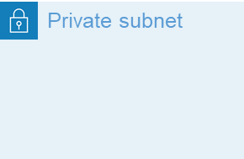
Understanding with Use-Case
Company XYZ is getting lot of attacks from a random IP 128.190.12.32. The company has more than 500 servers and Security team decided to block that IP in firewall for all the servers.
How to go ahead and achieve that goal ?
250 EC2
Network ACL
250 EC2
DENY 128.190.12.32

Slide 105
Important Pointers
Each subnet in your VPC must be associated with a network ACL. If you don't explicitly associate a subnet with a network ACL, the subnet is automatically associated with the default network ACL.
Default NACL allows all inbound and outbound IPv4 traffic and, if applicable, IPv6 traffic.
You can associate a network ACL with multiple subnets. However, a subnet can be associated with only one network ACL at a time.
knowledge portal

Slide 106
Amazon Machine Image
Let’s Image

Slide 107

Overview of AMI
Amazon Machine Image (AMI) is the master image from which new EC2 instances can be launched.
Let’s understand with an example:
Security Hardening
Configure SELinux
Configure firewalld
Install IPS agent
Configure Auditd
Create Security user
Amazon Linux
Hardened Amazon Linux
knowledge portal

Slide 108
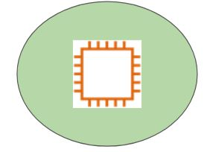
Hardened AMI
EC2 Instances
Hardened Amazon Linux
Prod AWS Account
knowledge portal

Slide 109
Launch Templates
Launching EC2 The Easy Way

Slide 110
Understanding the Challenge
When you launch an EC2 instance, there are various configurations that needs to be set.
Some of the common configuration includes:
AMI ID
Instance Type
Security Group
Key Pair
Storage
IAM Role
VPC
Everytime when you intend to launch instance, going through process is time consuming,
knowledge portal

Slide 111
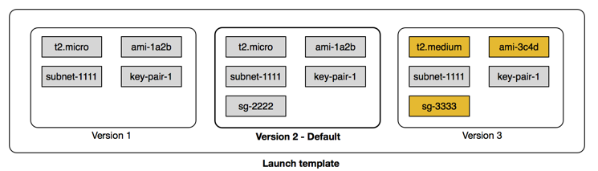
Introduction to Launch Templates
Launch templates enable you to store launch parameters so that you do not have to specify them every time you launch an instance.
knowledge portal

Slide 112
EC2 Pricing
Cost Optimization

Slide 113
Paying for EC2 Instances
There are fives primary ways in which we can pay for EC2 instance usage.
On-Demand
Savings Plan
Reserved Instances
Spot Instances
Dedicated Hosts
knowledge portal

Slide 114

On-Demand Pricing
With On-demand instances, we pay for compute capacity per hour or per second depending on the instances which is being run.
No upfronts payments are needed and we can increase or decrease the capacity whenever it is needed.
knowledge portal

Slide 115
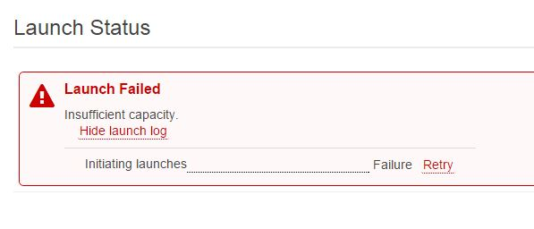
On-Demand Can Lead to Unexpected Issues
Monday: 500 customers using 16GB RAM on-demand servers individually.
Wednesday: 30 customers using 16GB RAM on-demand servers individually.
A “Cloud Service Provider” will not have a clear picture on how many servers should the provision. Too high → resources might unused and too low → money loss
knowledge portal

Slide 116
Reserved Instance
Reserved Instance provides us with significant discount (upto 75%) compared to on-demand instance pricing.
Reserved instance are assigned to a specific availability zone and provides capacity reservation for AWS EC2 instances.
Example :
You know you will always be running 20 servers of m4.2xlarge type of 1 year, then buy reserved instances for them.
knowledge portal

Slide 117
Reserved Instance - Part 2
Example: g4dn.8xlarge instance type
Pricing Option | Hourly Cost | Total 3 year cost
On-Demand Instance | $2.176 | $57,276
3 year all up-front - Reserved | - | $21502
Savings |  | ~62%
knowledge portal

Slide 118
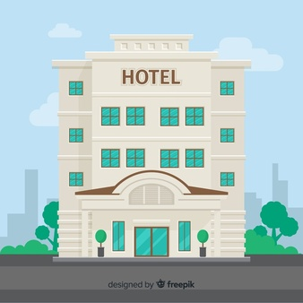
Spot Instance
Spot instances allows us to bid on spare Amazon EC2 computing capacity for up to 90% of the on-demand cost.
Such instances are recommended for applications that can have flexible start and end times
knowledge portal

Slide 119
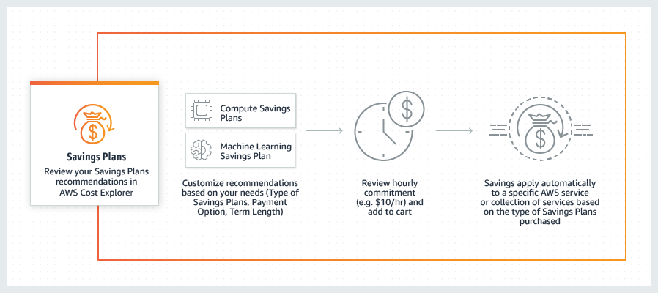
Savings Plans
Savings Plans are a flexible pricing model that offer low prices on EC2 and Fargate usage, in exchange for a commitment to a consistent amount of usage (measured in $/hour) for a 1 or 3 year term.
knowledge portal

Slide 120
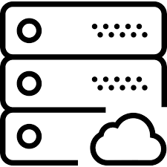
Dedicated Host
A dedicated host is a physical EC2 server dedicated for your use.
It can be purchased on-demand as well as reserved instance.
knowledge portal

Slide 121


Join us in our Adventure
kplabs.in/twitter
Be Awesome
kplabs.in/linkedin
instructors@kplabs.in

